Slide 1

TOPIC 3:CAPITAL BUDGETING

Slide 2
Content
Nature and importance of investment decisions
Capital budgeting definition
Cash flow components and computation of cash flows
Discounting and non-discounting capital budgeting techniques.
Evaluating projects and ranking them based on the budgeting techniques.

Slide 3
Nature of Investment Decisions
Efficient allocation of firm’s capital to long term assets/ projects is a very important finance decision.
The investment decisions of a firm are generally known as the capital budgeting or capital expenditure decisions.
The firm’s investment decisions would generally include expansion, acquisition, modernisation and replacement of the long-term assets. Sale of a division or business (divestment) is also as an investment decision.

Slide 4
Nature of Investment Decisions
Some decisions have long-term effect on the firm’s expenditures and benefits and hence should also be evaluated as investment decisions.
They include;
Change in the methods of sales distribution
Advertisement campaign
Research and development program

Slide 5
Definition of capital budgeting
Efficient allocation of available funds/capital to long term assets/projects with the expectation of receiving future benefits.
It entails foregoing current consumption in order to receive future benefits over a number of years.
Capital budgeting is considered important as it tends to determine the firm value by influencing its growth, profitability and risk.

Slide 6
Features of Investment Decisions
Involves the exchange of current funds for future benefits.
The funds are invested in long-term assets.
The future benefits will occur to the firm over a series of years.

Slide 7
Importance of Investment Decisions
Growth
A wrong investment decision can be disastrous for continued survival of the firm.
Example, unprofitable expansion of assets could lead to increased costs.
On the other hand, inadequate investment in assets could make it difficult for the firm to compete successfully.

Slide 8
Importance of Investment Decisions
Risk
Long-term commitment of funds may change the firm’s risk level.
A business may become more risky if they invest in a project whose cashflows fluctuate frequently.
Funding
Investment decisions involve commitment of large amount of funds.
Firm’s therefore need to carefully plan their investment programmes and make an advanced arrangement for sourcing funds internally or externally.

Slide 9
Importance of Investment Decisions
Irreversibility
Most investment projects are irreversible or reversible at substantial loss.
It may be difficult to find a market for some assets once acquired or the firm incurs huge losses when the assets are scrapped.
Complexity
Investment decisions are among the most difficult firm decisions as they involve assessment of future cash flows that are difficult to predict due to uncertainties.

Slide 10
Types of Investment Decisions
One classification is as follows:
Expansion of existing or new business
Replacement and modernization
Another way to classify investments is as follows:
Mutually exclusive investments
Independent investments
Contingent investments

Slide 11
Types of Investment Decisions
Classification I:
Expansion of existing or new business
A firm may add capacity to its existing lines so as to expand operations/production (related diversification)
It may also expand activities in a new business such as producing a new product for the first time (unrelated diversification)
A company may also acquire another existing firm to expand business.
NB: The reason of expanding in all cases is to earn additional revenues in the future.

Slide 12
Types of Investment Decisions
Classification I:
Replacement and modernization
The main reason for modernization and replacement is to improve operating efficiency and reduce costs.
Replacement decisions lead to introduction of more efficient and economical assets hence reducing costs.
Assets that involve substantial modernization and technological improvement expand revenues as well as reduce costs.

Slide 13
Types of Investment Decisions
Classification II:
Mutually exclusive investments
These investments serve the same purpose and compete.
Undertaking one of these investments means excluding the other competing investments.
Independent investments
The investments serve different purposes and do not compete.
Depending on their profitability and availability of funds ,a firm can undertake both investments.

Slide 14
Types of Investment Decisions
Classification II:
Contingent investments
This investments are dependent projects.
The choice of one investment requires undertaking one or more other investments.

Slide 15
Investment Evaluation Criteria
Three steps are involved in the evaluation of an investment:
Estimation of cash flows.
Estimation of the required rate of return (the opportunity cost of capital)
Application of a decision rule/capital budgeting technique/investment criteria in making the investment choice.

Slide 16
Characteristics of a sound technique
A sound appraisal technique should:
Consider all cashflows to determine profitability of projects.
Provide a way of separating good and bad projects.
Rank ventures according to their viability.
Rank a venture that brings in return earlier and in large lumpsums first than a venture bringing in late and less inflows over the same period.
Help to choose the project that maximizes shareholders wealth among mutually exclusive projects.

Slide 17
Evaluation Criteria
1. Non-discounted Cash Flow Criteria
Payback Period (PB)
Accounting Rate of Return (ARR)
2.Discounted Cash Flow (DCF) Criteria
Net Present Value (NPV)
Internal Rate of Return (IRR)
Profitability Index (PI)

Slide 18
PAYBACK (Constant cash flows)
Payback is the number of years required to recover the original cash outlay invested in a project.
If the project generates constant annual cash inflows, the payback period can be computed by dividing cash outlay by the annual cash inflow. That is:

Slide 19
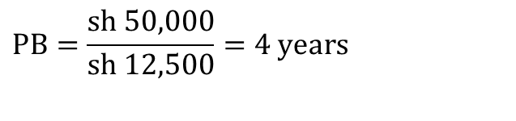
Example
Assume that a project requires an outlay of sh 50,000 and yields annual cash inflow of sh 12,500 for 7 years. The payback period for the project is:
$$\text{PB}=\frac{\text{s}\text{h}\text{ 50,000}}{\text{sh}\text{ 12,}\text{5}\text{00}}=4 \text{years}$$

Slide 20
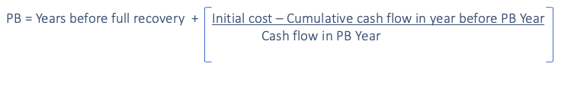
PAYBACK (uneven cash flows)
Unequal cash flows In case of unequal cash inflows, the payback period can be found out by adding up the cash inflows until the total is equal to the initial cash outlay.
Formula:

Slide 21
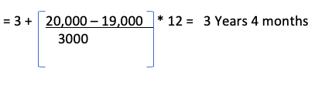
PAYBACK (uneven cash flows)
A project requires a cash outlay of Kshs. 20,000 and generates cash inflows of Kshs.8,000;Kshs.7,000;Kshs.4,000; and Kshs.3,000 during the next 4 years. What is the project’s payback?
Solution
Year | Cash inflow | Accumulated cash flow
1 | 8000 | 8000
2 | 7000 | 15000
3 | 4000 | 19000
4 | 3000 | 22000

Slide 22
Example 2
What is the PBP for a project that costs Sh.80,000 and yields the following cash inflows for 5 years:
Solution
The Sh.80,000 cost is recovered between year 4 and 5. During year 5 (after year 4) Sh.5,000 is (80,000 – 75,000) is required out the total year 5 cash flows of 30,000.
Therefore the PBP = = 4 years 2 Months
Year | 1 | 2 | 3 | 4 | 5
Cash inflow | 10000 | 30000 | 15000 | 20000 | 30000
Year | Cash inflow | Accumulated cash flow
1 | 10000 | 10000
2 | 30000 | 40000
3 | 15000 | 55000
4 | 20000 | 75000
5 | 30000 | 105000

Slide 23
Acceptance Rule
The project would be accepted if its payback period is less than the maximum or standard payback period set by management.
As a ranking method, it gives highest ranking to the project, which has the shortest payback period and lowest ranking to the project with highest payback period.
For mutually exclusive projects, the project with a shorter PBP is selected.

Slide 24
Evaluation of Payback
Pay back method is considered to have some virtues:
Simplicity
Cost effective
Limitations:
Ignores cash flows after payback period
Ignores time value of money
Does not measure the profitability of venture
It may be difficult for a firm to determine the standard PBP

Slide 25
ACCOUNTING RATE OF RETURN
This method uses accounting profits from financial statements to assess the viability of investment proposals by dividing the average income after tax by average investment.
The average investment would be equal to half of the original investment if it were depreciated constantly.
It can also be computed through dividing the total of investments book values after depreciation by the life of the project.

Slide 26
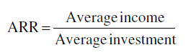
ACCOUNTING RATE OF RETURN
Note:
Straight line Depreciation = Initial investment- Scrap value
Useful life
Average investment = Initial investment + scrap value
2

Slide 27
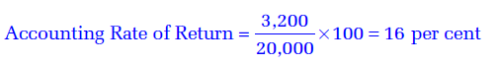
Example
A project will cost sh 40,000. Its stream of earnings before depreciation and taxes during first year through five years is expected to be sh 10,000, sh 12,000, sh 14,000, sh 16,000 and sh 20,000. Assume a 50 per cent tax rate and depreciation on straight-line basis. What is the ARR?

Slide 28
Accounting Rate of Return computation
 | 1 | 2 | 3 | 4 | 5
Earnings before Depreciation and taxes | 10,000 | 12,000 | 14,000 | 16,000 | 20,000
Less depreciation | (8,000) | (8,000) | (8,000) | (8,000) | (8,000)
Earnings before Tax (EBT) | 2,000 | 4,000 | 6,000 | 8,000 | 12,000
Less Taxes(50%) | (1,000) | (2,000) | (3,000) | (4,000) | (6,000)
Earnings After tax (Accounting profit) | 1,000 | 2,000 | 3,000 | 4,000 | 6,000
Depreciation = 40,000 - 0 = 8000
5
Average income = 1,000+2,000+3,000+4,000+6000
5
= 3200
Average investment =40,000 + 0 = 20,000
2

Slide 29
Example
Shs.
Project X cost 500,000
Scrap value 100,000
Stream of income before depreciation and taxes are as follows:
Shs.
Year 1 100,000
Year 2 120,000
Year 3 140,000
Year 4 160,000
Year 5 200,000
Let tax = 50% and depreciation straight line. Calculate the accounting rate of return.

Slide 30
Acceptance Rule
This method will accept all those projects whose ARR is higher than the minimum rate established by the management and reject those projects which have ARR less than the minimum rate.
This method would rank a project as number one if it has highest ARR and lowest rank would be assigned to the project with lowest ARR.

Slide 31
Evaluation of ARR Method
Merits
Simplicity
Accounting data
Shortcomings
Cash flows ignored
Time value ignored
It does not consider how soon the investment should recover the cost

Slide 32
Net Present Value Method
Cash flows of the investment project should be forecasted based on realistic assumptions.
Appropriate discount rate should be identified to discount the forecasted cash flows.
Present value of cash flows should be calculated using the opportunity cost of capital as the discount rate.
Net present value should be found out by subtracting present value of cash outflows from present value of cash inflows. The project should be accepted if NPV is positive (i.e., NPV > 0).

Slide 33
Net Present Value Method
The formula for the net present value can be written as follows:
NPV= PV Cash inflows – PV Cash outflows

Slide 34
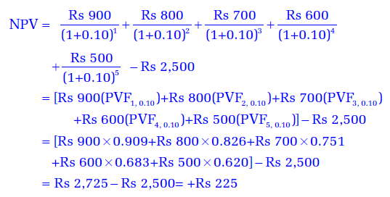
Calculating Net Present Value
Assume that Project X costs sh 2,500 now and is expected to generate year-end cash inflows of sh 900, sh 800, sh 700, sh 600 and sh 500 in years 1 through 5. The opportunity cost of the capital may be assumed to be 10 per cent.

Slide 35
Example
Jeremy limited wishes to expand its output by purchasing a new machine worth 170,000 and installation costs are estimated at 40,000/=. In the 4th year, this machine will call for an overhaul to cost 80,000/=. Its expected inflows are:
Shs
Year 1 60,000
Year 2 72,650
Year 3 35,720
Year 4 48,510
Year 5 91,630
Year 6 83,715
This company can raise finance to purchase machine at 12% interest rate.
Compute NPV and advise management accordingly.

Slide 36
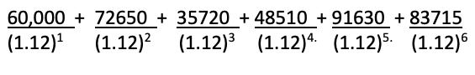
Solution
Shs.
PV of outflows
Cost of machine at present value 170,000
Installation cost 40,000
210,000
Overhaul cost in the 4th year PV ( 80,000 * (1.12)⁻ ⁴ 50,841.45
Total present value of investment 260,841.45
PV inflows
= 262,147.28
Therefore: NPV = 262,147.28 – 260,841.45
= 1,305.83
The NPV is positive and I would advise the management to invest.

Slide 37
Question
Kiwanda Limited is considering the purchase of a new machine. Two alternative machines, Pesi TZO and Upesi MO2, which will cost Sh.7,000,000 each are available in the market. The cash flow after taxation of each machine are as follows:
Cash flow
Year | Pesi TZO | Upesi MO2
 | Sh. | Sh.
1 | 600,000 | 1,800,000
2 | 1,800,000 | 2,400,000
3 | 2,000,000 | 3,000,000
4 | 3,000,000 | 1,800,000
5 | 2,400,000 | 1,600,000
Calculate each project’s:
Payback period (4 marks)
Net present value (NPV) at 12% (4 marks)
Internal rate of return (IRR) (6 marks)
Profitability index (PI) at 12% (3 marks)
Should both projects be accepted if they are dependent? (1 mark)
Which project should be accepted if they are mutually exclusive?(2 marks)

Slide 38
Acceptance Rule
Accept the project when NPV is positive NPV > 0
Reject the project when NPV is negative NPV < 0
May accept the project when NPV is zero NPV = 0
The NPV method can be used to select between mutually exclusive projects; the one with the higher NPV should be selected.

Slide 39
Evaluation of the NPV Method
NPV is most acceptable investment rule for the following reasons:
Time value
Shareholder value
Limitations:
Involved cash flow estimation
Discount rate difficult to determine
difficult to use.
Not good assessment if the projects are unequal lives, returns or costs.

Slide 40
INTERNAL RATE OF RETURN METHOD
This method is a discounted cash flow technique which uses the principle of NPV.
IRR = Pv (cash inflows) = Pv (cash outflows) or IRR is the cost of capital when NPV = 0.
It is also called internal rate of return because it depends wholly on the outlay of investment and proceeds associated with the project and not a rate determined outside the venture.

Slide 41
Question
A project costs 16,200/= and is expected to generate the following inflows:
Shs.
Year 1 8,000
Year 2 7,000
Year 3 6,000
Compute the IRR of this venture.
The cost of capital is 10%

Slide 42
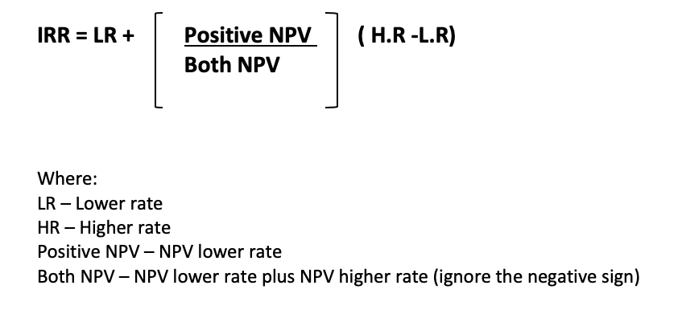
Interpolation method
IRR can be found by:
) By interpolation

Slide 43
Interpolation method
Difference
PV at rate of 10% = 17,565.4
1365.4
PV required = 16,200.000
PV at rate of 20% = 14,999.4 -1200.6
Therefore, IRR = 10% + 1365.4 ( 20% -10%)
( 1365.4+1200.6)
= 10% + 5.32%
= 15.32 %

Slide 44
Acceptance Rule
Accept the project when IRR> Cost of capital
Reject the project when IRR < Cost of capital
May accept the project when IRR = Cost of capital
Projects with IRR greater than the cost of capital are accepted since they offer a higher return than the cost of financing the project. The cost of capital is the cost of financing.
In case of independent projects, IRR and NPV rules will give the same results if the firm has no shortage of funds.

Slide 45
Advantages of IRR
It considers time value of money
It considers cash flows over the entire life of the project.
It is compatible with the maximization of owner’s wealth because, if it is higher than the cost of finance, owners’ wealth will be maximized.

Slide 46
Disadvantages of IRR
Difficult to use.
Expensive to use because it calls for trained manpower and may use computers especially where inflows are of large magnitude and extending beyond the normal limits.
It may give multiple results some involving positive IRR in which case it may be difficult to use in choosing which venture is more viable.

Slide 47
PROFITABILITY INDEX
This is the ratio of the Present Value of the expected Cash flows at the required rate of return to the initial cash outflow of the investment. This can be illustrated as:
Profitability Index(PI) = (PV of future cash flows)
Initial investment

Slide 48
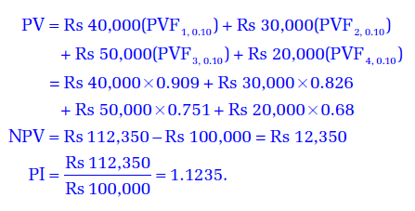
PROFITABILITY INDEX
The initial cash outlay of a project is Rs 100,000 and it can generate cash inflow of Rs 40,000, Rs 30,000, Rs 50,000 and Rs 20,000 in year 1 through 4. Assume a 10 percent rate of discount. The PV of cash inflows at 10 percent discount rate is:

Slide 49
Acceptance Rule
The following are the PI acceptance rules:
Accept the project when PI is greater than one PI > 1
Reject the project when PI is less than one PI < 1
May accept the project when PI is equal to one. PI = 1
The project with positive NPV will have PI greater than one. PI less than means that the project’s NPV is negative.

Slide 50
Evaluation of PI Method
Time value: It recognises the time value of money.
Value maximization: It is consistent with the shareholder value maximisation principle. A project with PI greater than one will have positive NPV and if accepted, it will increase shareholders’ wealth.
Relative profitability: In the PI method, since the present value of cash inflows is divided by the initial cash outflow, it is a relative measure of a project’s profitability.
Like NPV method, PI criterion also requires calculation of cash flows and estimate of the discount rate. In practice, estimation of cash flows and discount rate pose problems.

Slide 51
THANK YOU

